Slide 1
Myntra
Analysis

Slide 2
Introduction to Myntra.com
Overview
Founded in 2007 by Ashutosh Lawania,Mukesh Bansal,Raveen Sastry,Sankar Bora,Vineet Saxena.
Myntra is an e-commerce company committed to making fashion and lifestyle products accessible to everyone
Mission: To use technology to make fashion and lifestyle more accessible and help people look good.
Vision: To make the world more stylish through fashion

Slide 3
Myntra Business Model
Myntra, an Indian e-commerce company, operates on a business-to-consumer (B2C) marketplace model
Myntra's business model allows multiple businesses to operate within its portal, providing customers with a variety of options. Myntra works directly with merchants to introduce and establish brands.
Myntra's target market is young, fashion-conscious, medium-income online shoppers who are looking for good quality products and the best deals
Myntra offers products from over 2,500 brands, including national and global brands
Myntra's marketing strategy focuses on segmentation, targeting, and positioning
Myntra launched an express delivery service in May 2022, allowing shoppers to receive orders within 24–48 hours of purchase

Slide 4
Market Position and Growth
Market Position
Myntra compete with Amazon Fashion,Flipkart,AJIO
Myntra is India's largest fashion e-commerce player, with a market share estimated to be between 35% and 45% as of 2023.
Myntra has over 400 international brands in its portfolio, including Mango, H&M, and Tommy Hilfiger
Myntra is expanding into non-metro cities
Growth Trajectory
Myntra's growth is attributed to customer acquisition, innovation, and operational excellence
monthly active users (MAUs) increased from 45 million in 2021 to 60 million by the end of 2023
The catalog size on the platform has grown by over 50% in the last year.
Myntra's GMV (gross merchandise value) growth is nearing 2X of the market.

Slide 5
Myntra Revenue Model(2022-2023)
ADVERTISEMENT SERVICE: 2022-2023 Revenue: INR-535.3 crore which is 11.9% of total revenue
OTHER INCOME such as interest income or rental income, which contributes 2.97% to the total revenue
OTHER OPERATING REVENUE includes miscellaneous revenue sources, accounting for 1.49% of the total.
Total Operating Revenue
(2022-2023): INR 4509.2 crore
LOGISTICS SERVICE: 2022-2023 Revenue: INR-1991.5 crore which is 44.2% of total revenue
MARKETPLACE SERVICE: 2022-2023 Revenue: INR-1781.2 crore which is 39.5% of total revenue

Slide 6
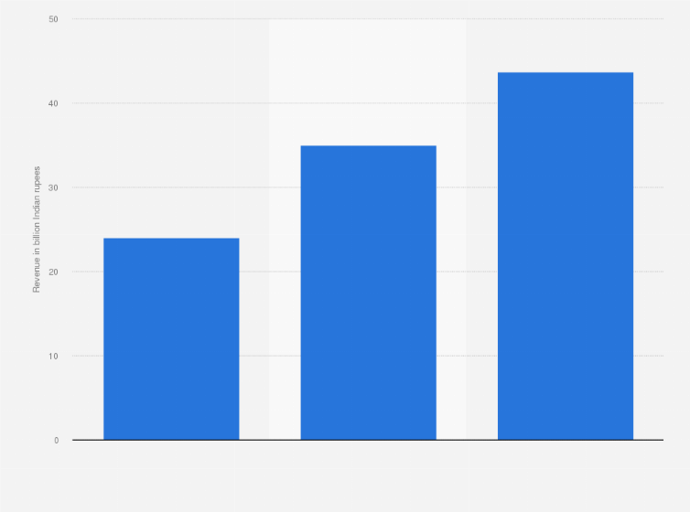
Operating revenue of Myntra for financial year 2021 to 2023(In Billion Indian Rupee)

Slide 7
Comparable online stores of Myntra.com in Fashion & Lifestyle in India
Top Online Stores in Fashion & Lifestyle in india
Website | Monthly site visit | Ratings
https://www.amazon.in/ | 210M | 4.3/5 (Glassdoor)
https://www.flipkart.com/ | 215M | 4.2/5 (Glassdoor)
https://www.myntra.com/ | 51.1M | 4.2/5 (Glassdoor)
https://www.meesho.com/ | 23.3M | 3.8/5 (Glassdoor)
https://www.ajio.com/ | 13.7M | 3.5/5 (Glassdoor)

Slide 8
Technology Utilization
Impact of Implementation
AI Implementation
Through the implementation of Assisted Selling Tools, including Virtual Try-On, an AI Skin Analyzer, and the Photo Search feature.
Myntra’s providing a personalised shopping experience to fashion and beauty shoppers and enabling consumers to discover products that suit their individual needs.
The integration of AR/VR technologies into offerings like the Virtual Try-On feature has notably allowed shoppers to upload a photo of themselves and virtually try on different apparel available on the platform
‘Photo Search’ feature, which generates results from Myntra’s comprehensive catalogue that are aligned to the shopper’s preference

Slide 9
Customer review analysis
Methodology:
Findings:
Analyzed social media Platforms(Twitter,Instagram,Facebook) and review sites(Trust pilot and google review)
Categorized reviews into High impact,low impact and medium impact
High impact reviews: Praise for Product quality and variety
Low impact reviews: Issue with delivery time and customer service

Slide 10
High Impact Review
Social media post attract consumer Effectively.
Myntra is promoting its upcoming sale from September 7th to September 12th, 2024, called the ‘Big Fashion Festival’ and also mentioning the ‘End of Reason Sale’. They encourage checking their website or app for the best offers.
App downloads increased by advertisement

Slide 11
Low Impact Review
Customer Complaints:
Service Issues: Multiple customers have expressed frustration with Myntra’s customer service. Complaints include poor handling of returns and delays in resolution.
Trust Issues: Some users have labeled Myntra as untrustworthy, accusing them of taking money without providing proper service.
Delivery Time: Most of the customer relevantly complaint regarding delivery beyond specified time

Slide 12
Medium Impact Review
Queries: Customer asking for more information or clarification against return refusal by myntra
Mixed Experience: Some customers share mixed feelings,mentioning both positive and negative comment about their shopping experience

Slide 13
Competitive Analysis
Competitor:
Amazon,Flipkart,AJIO,Nykaa
Competitive Advantage:
Diversification (Expanding into varied areas or fields) is one of the key factors that has kept the brand at the forefront of the fashion industry in the Indian market
Its focus on trendy, youth-centric clothing and a wide range of fashion products has made it one of the leading brands in India.
Comparison Factor:
Product Quality
Customer satisfaction
Delivery time

Slide 14
Strategic Recommendation
Customer Engagement:
Enhance customer service responsiveness and logistics
Marketing Strategy:
Enhance quality check of product from seller and to build trust by having proper proof
Product Development:
Introduce more organic and eco friendly product line

Slide 15
Website used for Analysis
For Revenue:
Startuptalky,com
For detailed competitor:
Semrush.com

